Slide 1


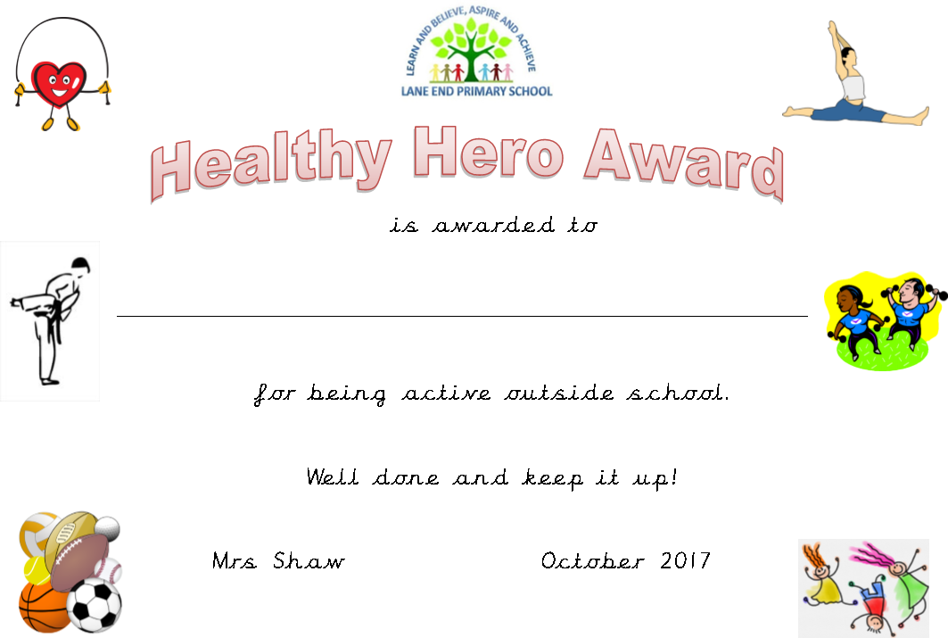
Welcome to our 1st Healthy Heroes Awards!

Slide 2
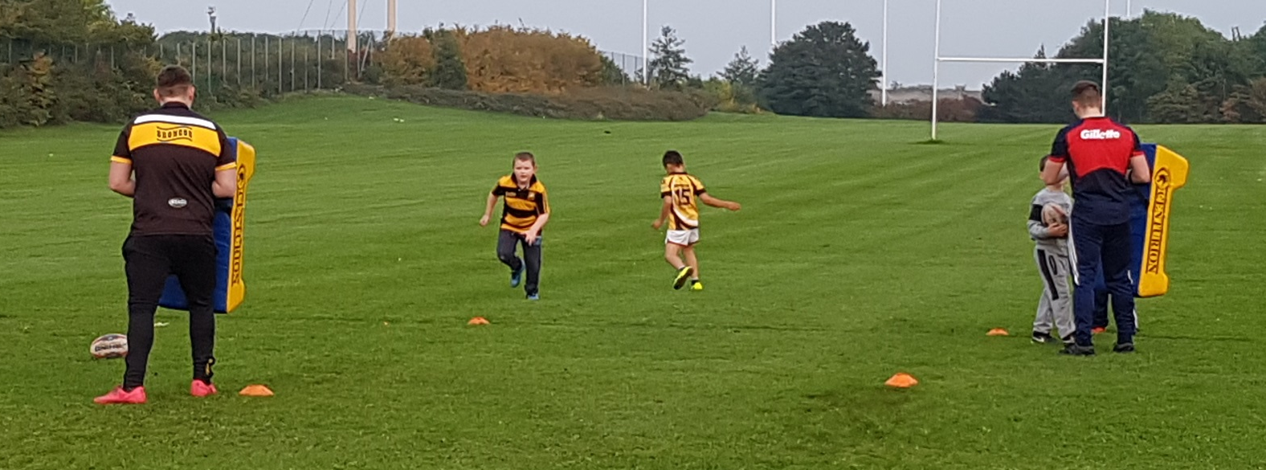
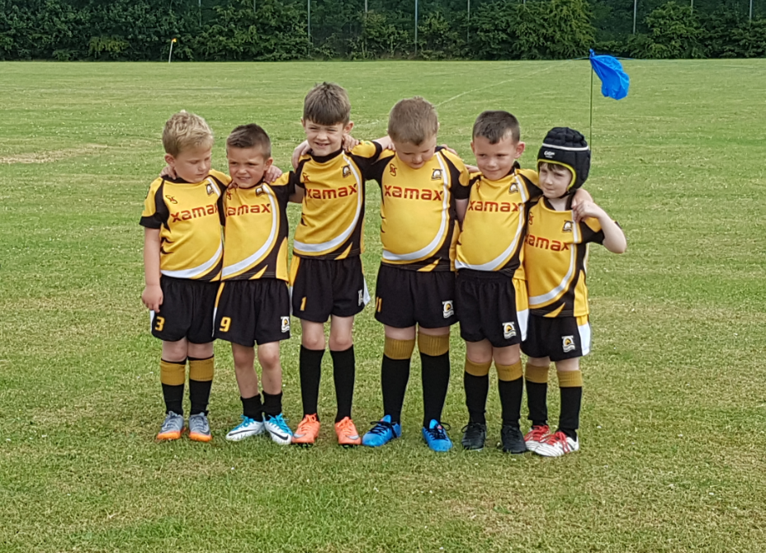
Tyler goes to Rugby Training each week.
Lucas goes too!

Slide 3
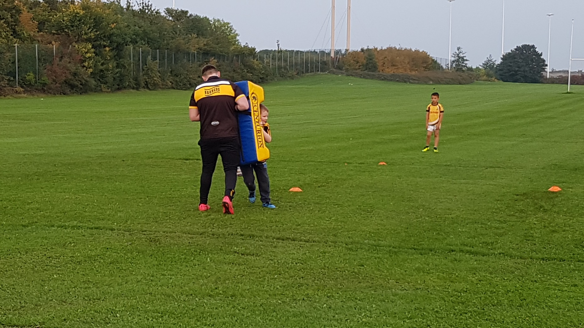
He builds his strength and fitness.

Slide 4
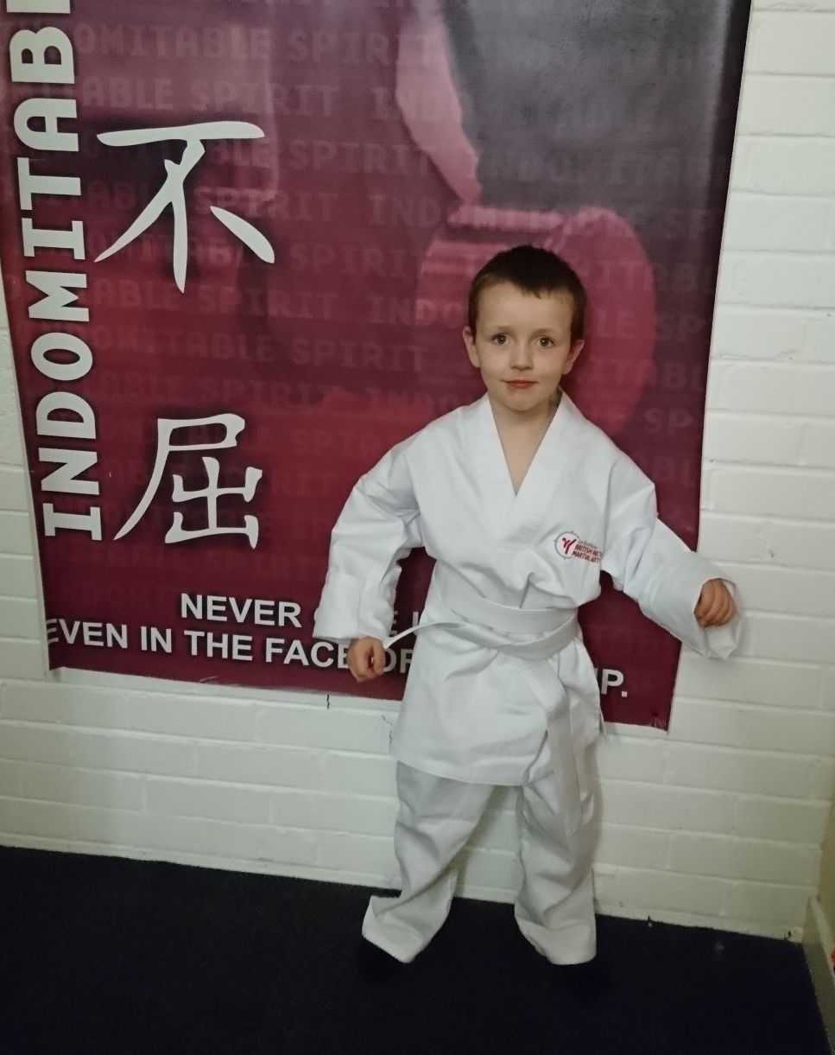
Brandon has started going to Martial Arts.

Slide 5
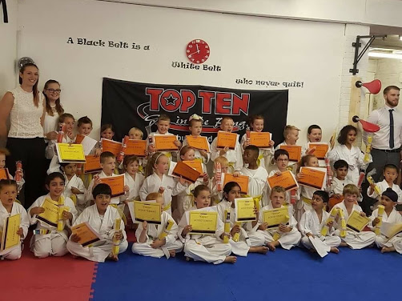
Yellow belt for Maheen. Fantastic!

Slide 6
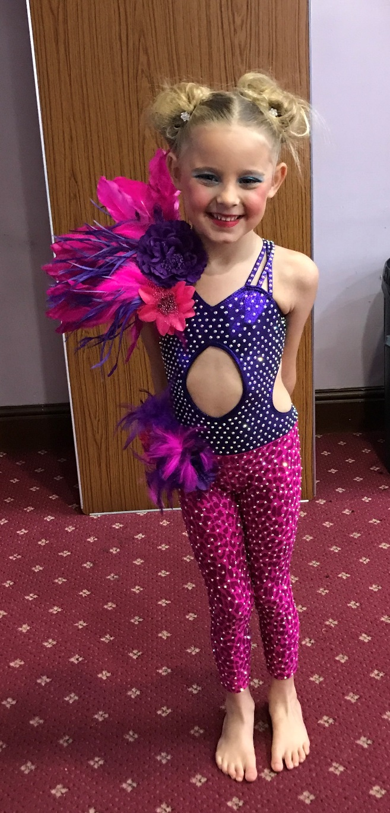
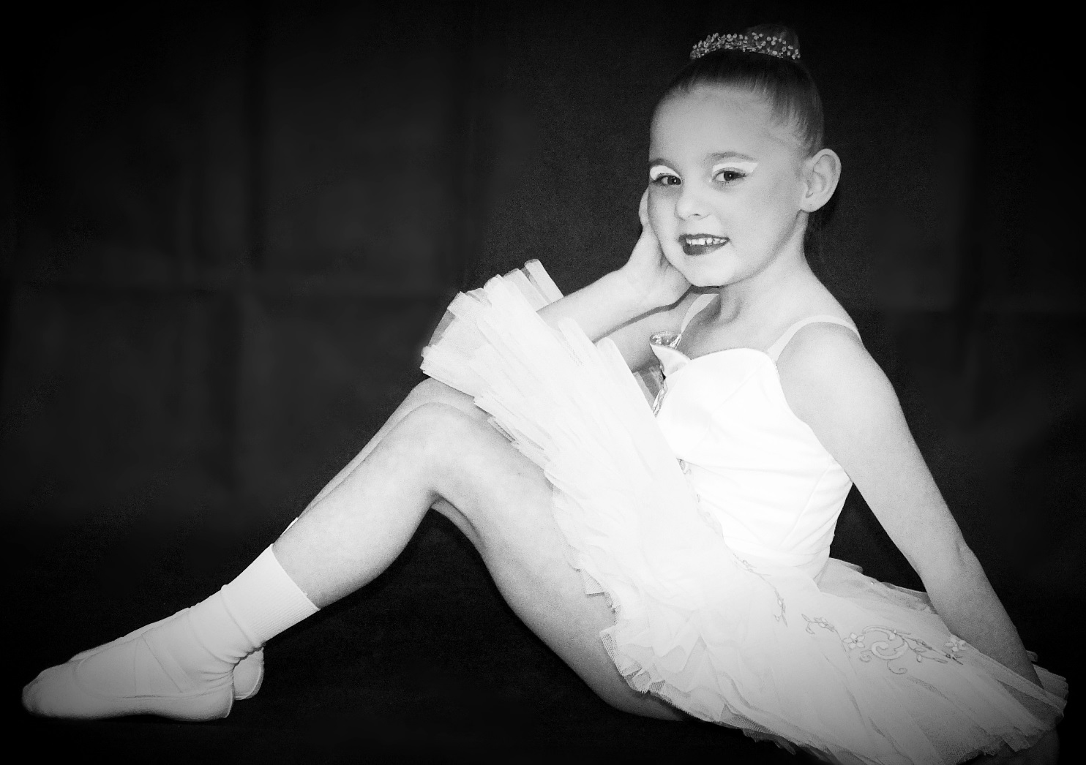
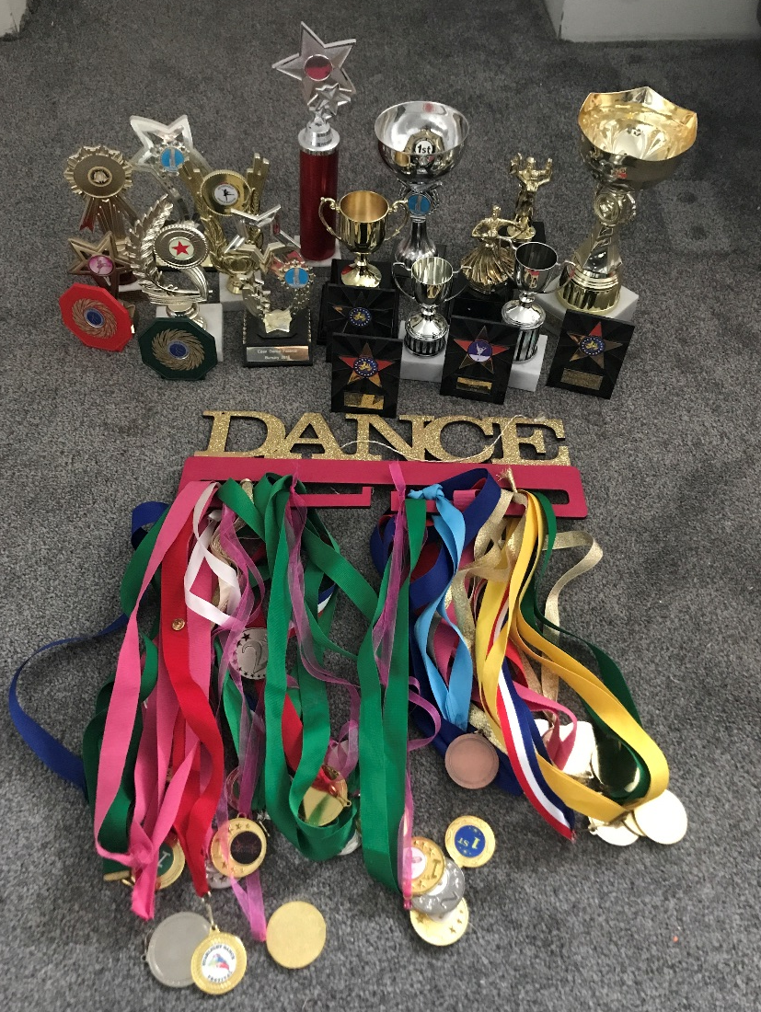
Laila Grace dances a lot!

Slide 7
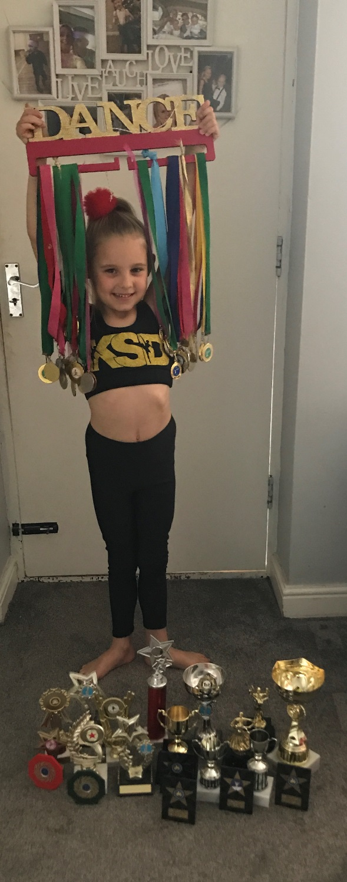
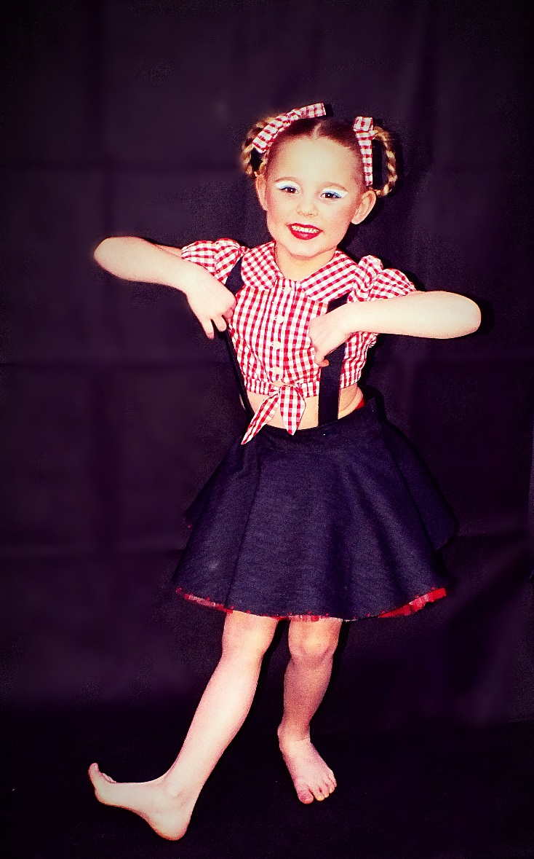
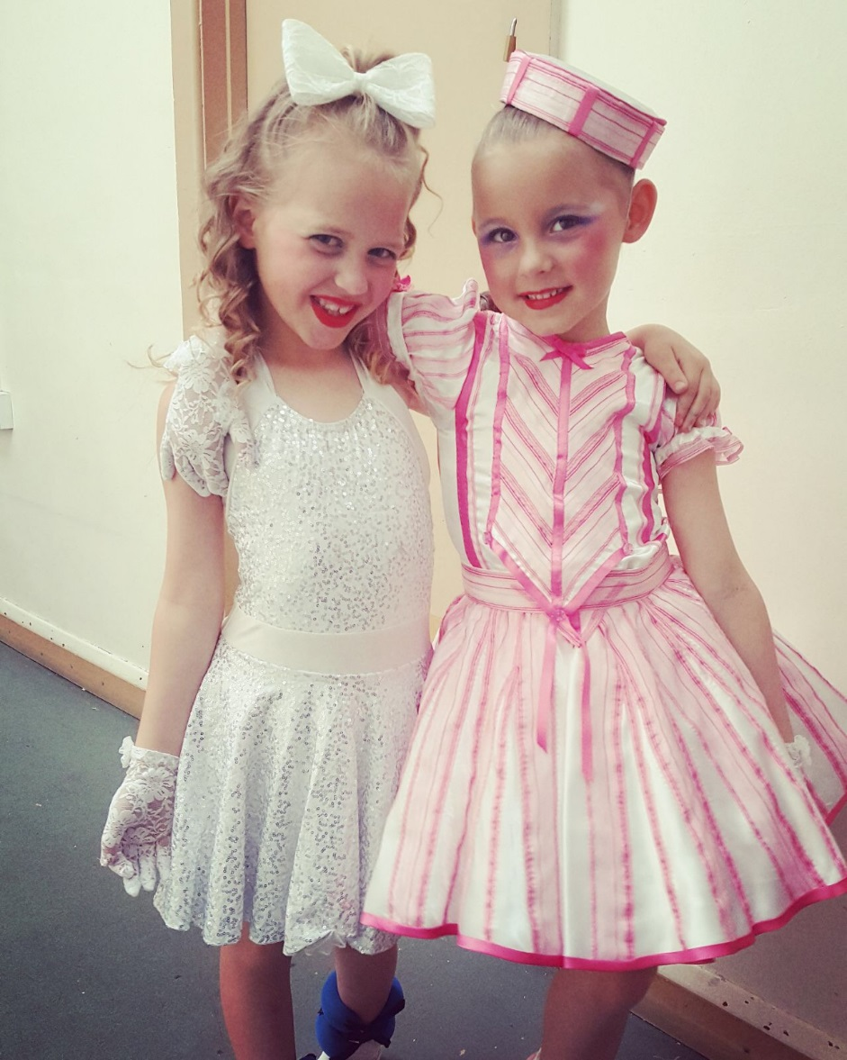
Keep it up Laila Grace!

Slide 8
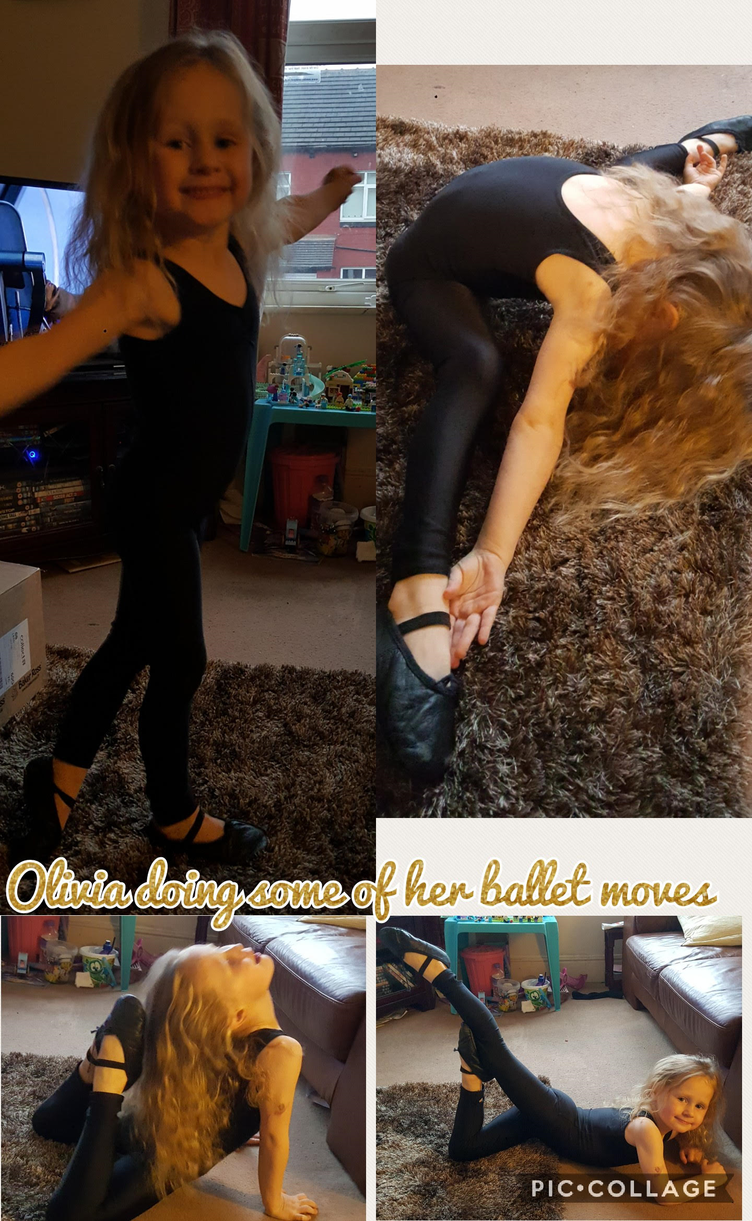
Olivia showing some great ballet skills!

Slide 9
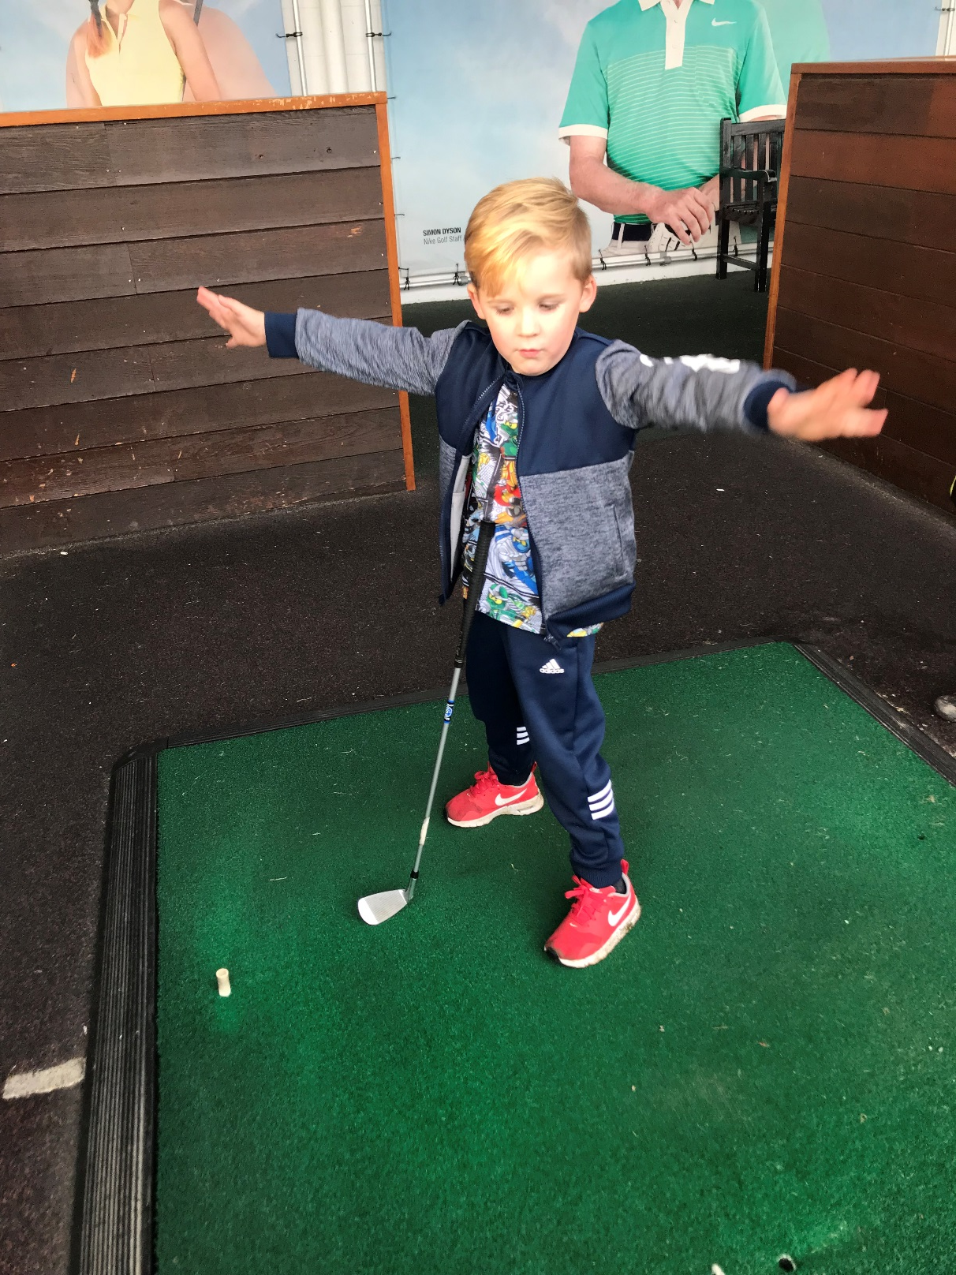
Kasper at his golf lesson.

Slide 10
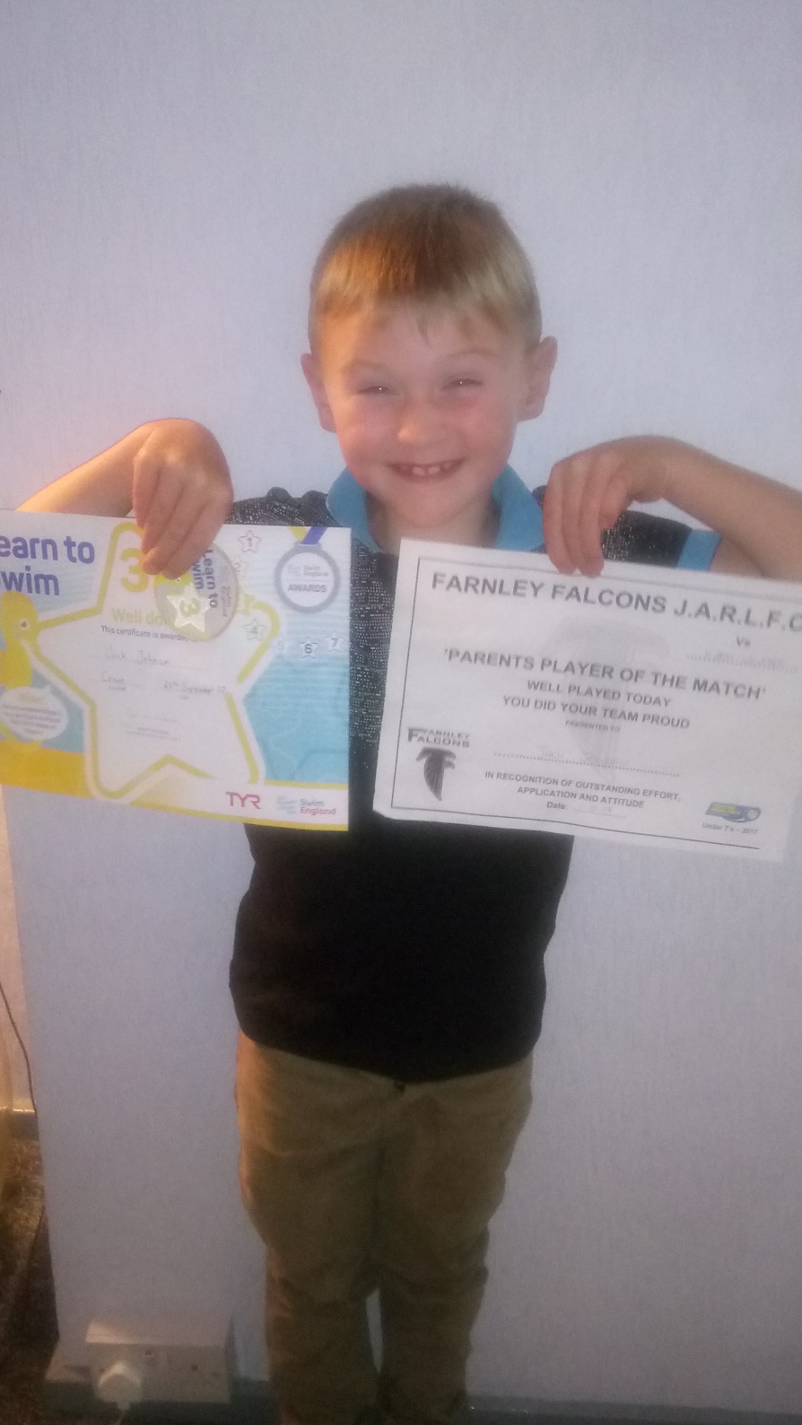
Jack is proud to have learned how to swim and to be voted ‘Player of the Match’ at Football.
Well done Jack.

